Slide 1

Micro Shooters
Inc.
A 2020 Javascript Phaser Multiplayer game

Slide 2
Basic Gameplay
PC based web app (Future mobile responsive)
Players can gain points by killing other enemies
The CarrierShips drop items that players can collect. Possible dropped items:
Weapon: upgrades laser level (max lvl 6)
Shield: player immune to dmg for 4 seconds
Life: player gains an extra life (max 5 lifes)
When they player receives a hit it respawns in the bottom center of the screen in shield mode for 3 seconds
All enemies have a different color/shape and AI functionalities
The player movement is in al 4 directions
The game currently has 7 levels (from which one is a Boss and the last one has an infinite spawn)

Slide 3
Gameflow
User visits the website
He receives a form to add a nickname.
He are redirected to the main menu where receives a greetings message and can click a button turn the sound on/off.
He can click another button to join the battlefield
User kills enemies and collects points or upgrades in order to advance to higher levels.
Current structure:
Level 0: 0-1000 points
Level 1: > 1000 points
Level 2: > 2500 points
Level 3: > 5000 points
Level 4: > 7000 points
Level 5: > 10000 points
Level Boss: > 150000 points
Level Infinite: unlock after killing the Boss

Slide 4
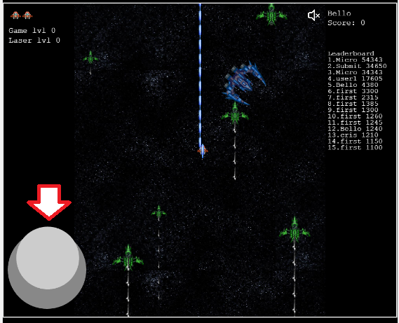
Controls
PC: UP, DOWN, LEFT and RIGHT arrow keys for movement and SPACE for shooting.
MOBILE: Use joystick displayed on the screen for the movement. Shooting is on auto mode.

Slide 5
Scenes
Get a form to request a nickname
Boot
Preloader
Main Menu
Game

Slide 6
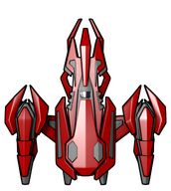
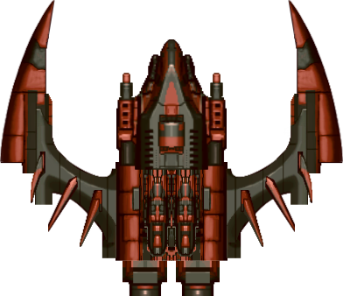
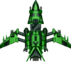

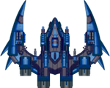




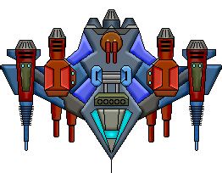
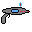
Graphics
Player
Enemies
Lasers (Player/Enemy)
Buttons
Droppings
Explosion
Shield:
Boss:

Slide 7

Sounds
Collect Star
Explosion
Laser
Background music
Item dropped
Button press
Button Hover
Enemy hit
Open the Power Point version of the file (.pptx) if you want to listen the audio files

Slide 8
Extra functions
Your score will automatically be registered when you lose all lives
Left side-bar:
Showing player available lives
Showing current Game level
Showing current Laser level
Right side-bar:
Showing nickname
Showing current user score
Showing the leaderboard with the first 15 highest scores of all time

Slide 9
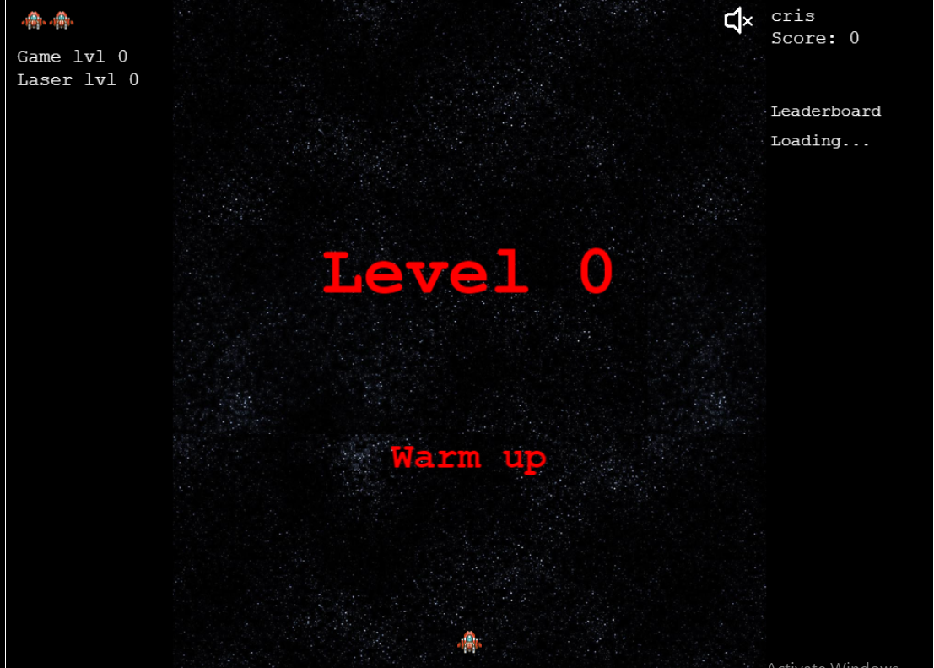
Level 0 – Warm Up
Enemies:
GunShip
CarrierShip
ChaserShip

Slide 10
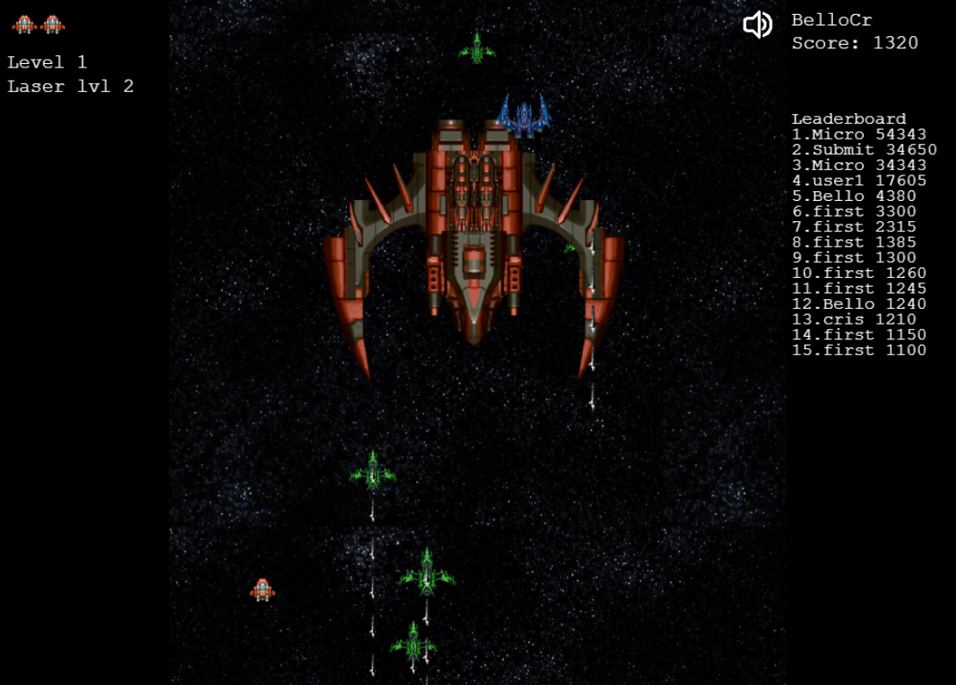
Level 1 – Same enemies with bigger health
Enemies:
GunShip
CarrierShip
ChaserShip

Slide 11
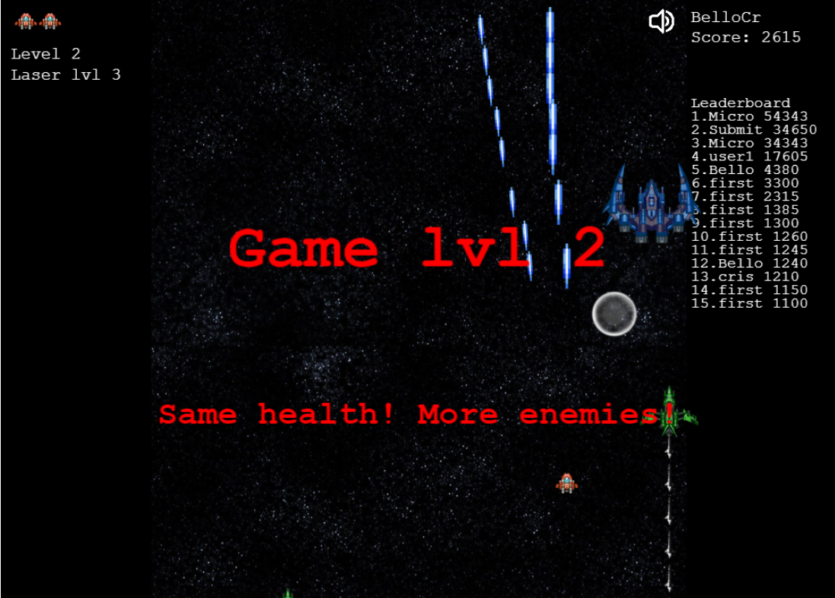
Level 2 – More spawned enemies and bigger health
Enemies:
GunShip
CarrierShip
ChaserShip

Slide 12
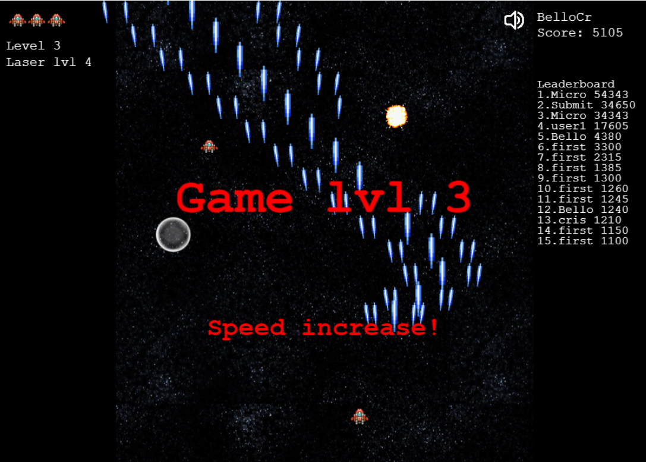
Level 3 – Speed boost for the enemies
Enemies:
GunShip
CarrierShip
ChaserShip

Slide 13
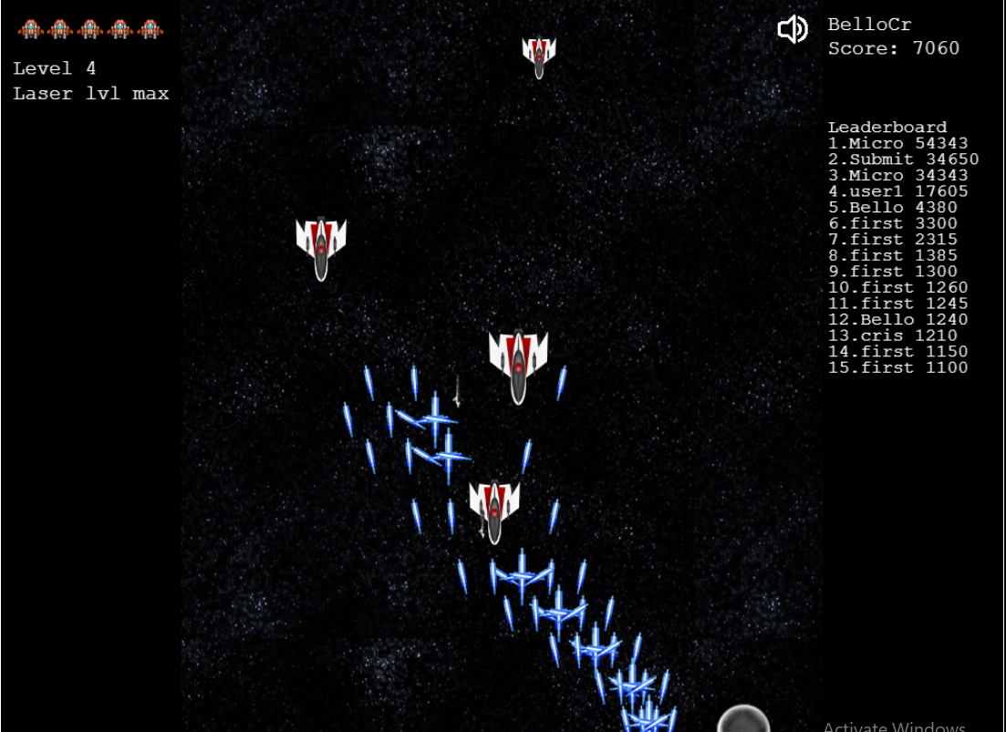
Level 4 – Falling airplanes (new enemy)
Enemies:
AirFighter
GunShip
CarrierShip
ChaserShip

Slide 14
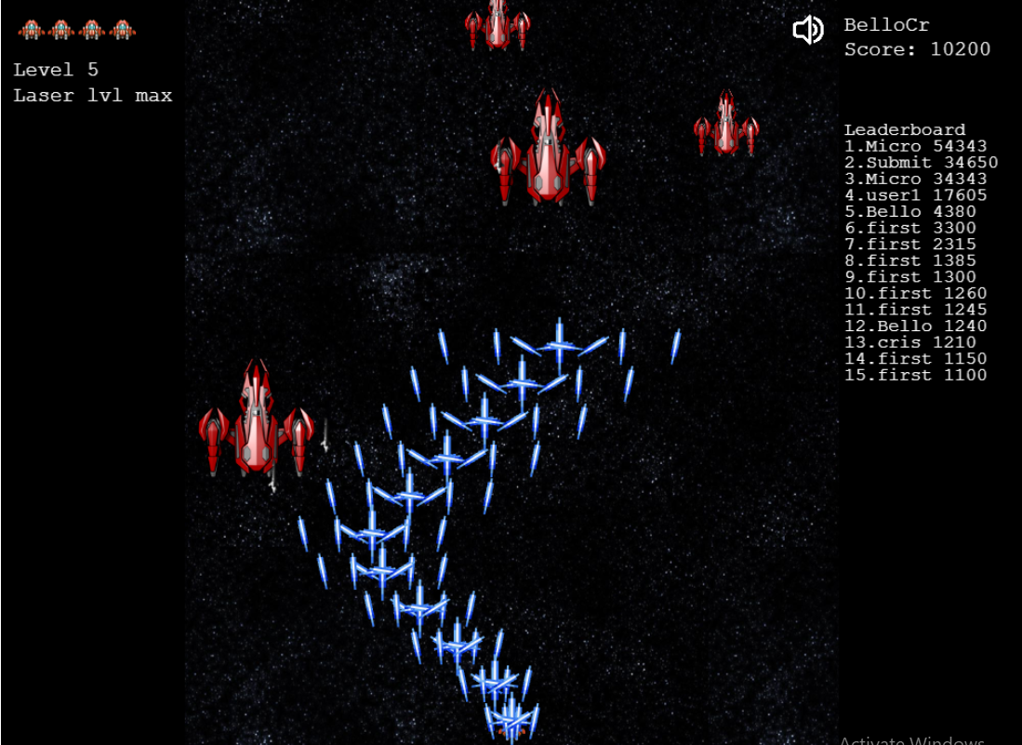
Level 5 – AI Ships (new enemy)
Enemies:
FighterShip
AirShip
GunShip
CarrierShip
ChaserShip

Slide 15
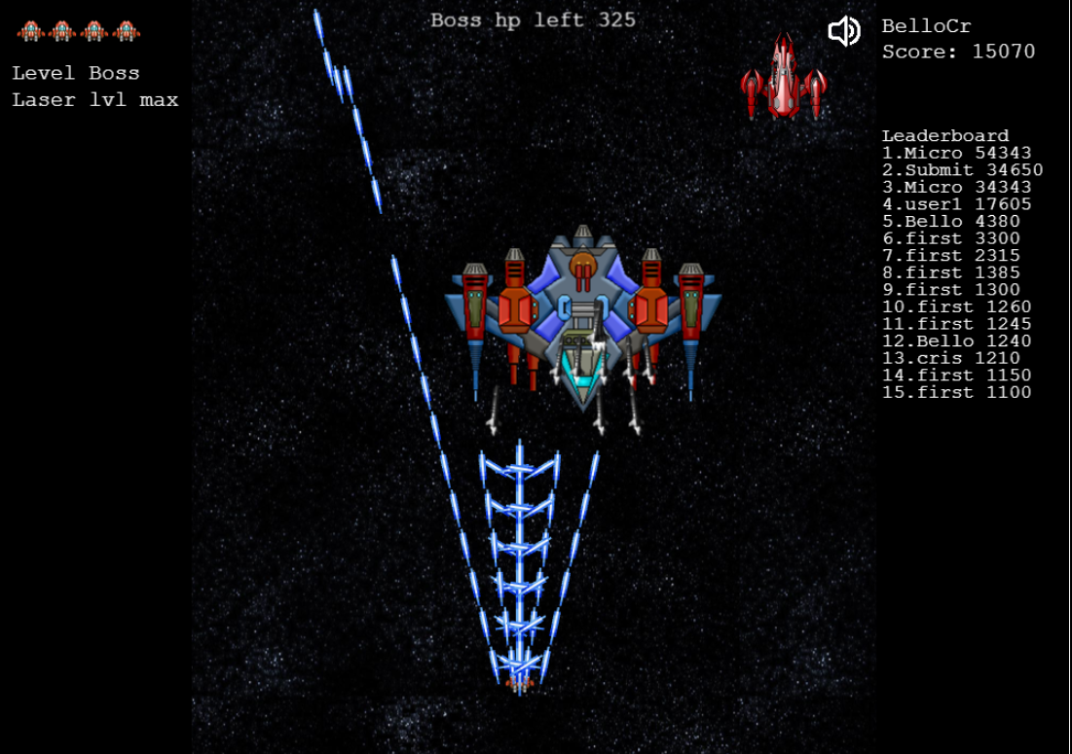
Level 6 – Boss Level (new enemy)
Enemies:
Boss
FighterShip
AirShip
GunShip
CarrierShip
ChaserShip

Slide 16
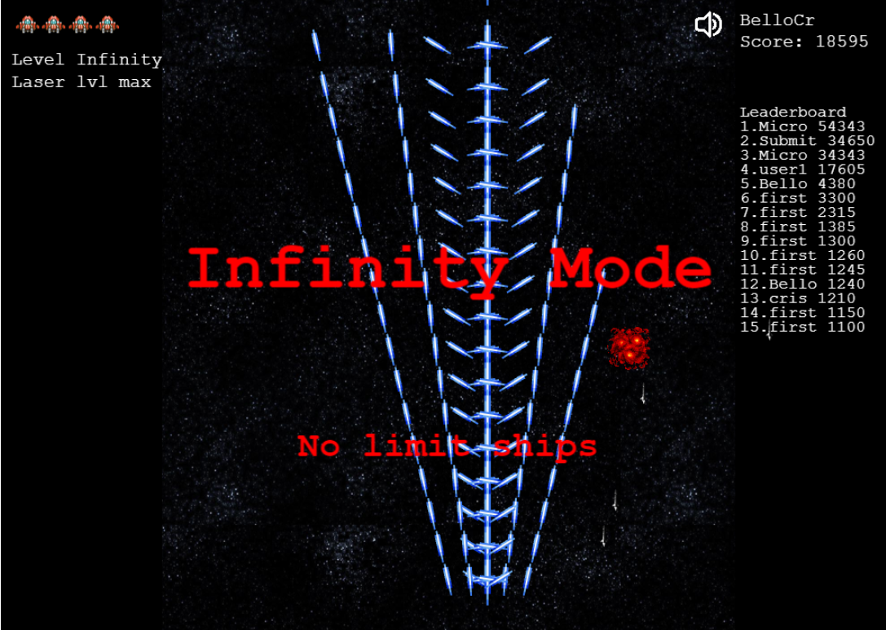
Infinity mode – no limit spawns of all enemies
Enemies:
Boss
FighterShip
AirShip
GunShip
CarrierShip
ChaserShip

Slide 17
Future improvements
Make the game playable on mobile devices
Create new worlds with different monsters and weapons
Add grenade functionality

Slide 18
Super improvements
Make the game multiplayer from the same PC and different PC`s (sockets)

Slide 19
Credits
Includes graphics from JS WARS by Jonas Wagner - http://29a.ch/
Thanks kalface@gmail.com blog: http://carlosalface.blogspot.pt/
Some of the sounds in this project were created by David McKee (ViRiX) soundcloud.com/virix
Sound On Off Images: Aaron Burke (itmatters.mobi)

